Slide 1

Go, change the world
RV College of
Engineering
“Contact Tracing using GPS Data and Machine Learning”
1RV20MC028
Ishita Sarkar
Under the Guidance
of
Dr Jasmine K.S Parag Jain
Associate Professor Reporting Analyst
RV College of Engineering EXL Services
®
9/5/2022 Department of MCA, RVCE

Slide 2

Go, change the world
RV College of
Engineering
Agenda
Introduction
Objectives of the Project Work
Changes suggested in Phase I and Incorporation
Tools and Technologies Used
Hardware and Software Requirements
Software Requirement Specifications
References

Slide 3
Go, change the world
RV College of
Engineering
Introduction and Objectives
Domain of the Project
The domain of the project is Machine Learning.
Problem Definition
  The health domain is always in need of developing technologies, whether in the form of machinery or software that can perform critical tasks. Such a crucial time for the health domain was when Covid struck and there was no way to fight such a disease or even know if someone was infected or not.
  During the Covid-19 pandemic the world saw a huge rise in the cases of people who got infected, most of those who got infected did come in contact with people who were already infected or were having symptoms.

Slide 4
Objectives of the Project Work
        To alert contacts to the possibility of infection and offer preventive services.
        To check whether the people who came in contact where already infected or not
        To locate a particular individual who is infected

Slide 5
Go, change the world
RV College of
Engineering
Incorporation of Changes
Introduction written in bullets points.
Detailed changes made in summary of literature survey.
Exact Proposed method is mentioned

Slide 6
Go, change the world
RV College of
Engineering
Project based Learning
Sl No
Particulars / Details
Details of Implementation
Sl No | Particulars / Details | Details of Implementation
1 | Course: Dataset storing Tool: Excel | To store the dataset in different format, manipulation of data as per requirement.
2 | Course: Data Visualization Tools: Matplotlib, Seaborn | provides a variety of visualization patterns, i.e. bars, pies, lines, scatter plots and so on.
3 | Course: ML Algorithms Types: Kmeans, KNN, DBscan, hierarchical Clustering. | Formation of clusters, finding the distance, training/testing the dataset, fitting the models and predictions.

Slide 7
Go, change the world
RV College of
Engineering
Design Methodology
List of tools / techniques that are to be used:
Python,
Machine Learning Algorithms,
Jupyter Notebook
Algorithms that can be used:
Density-based Clustering,
Hierarchal-based Clustering,
Partitioning-based Clustering etc.

Slide 8
Go, change the world
RV College of
Engineering
Design Methodology
Hardware Requirements
Processor: Intel® Core™ i3 processor, Ryzen 3 or above
Hard Disk: 500 GB or above
Memory (RAM): minimum 2GB
Ethernet connection (LAN) or wireless adapter (WiFi)
Graphical Processing Unit (GPU) 1050 Ti or above

Slide 9
Go, change the world
RV College of
Engineering
Design Methodology
Software Requirements
Operating System – Window 8-10, Linux 18.0
Browser – Chrome v101.0.4951.54, Microsoft Edge v100.0.1185.39
Programming languages – Python 3.6.0 or above
Visualization tools – Seaborn 0.11.2, Matplotlib 0.11.0
C:\Users\ISHITA\Downloads\Atul

Slide 10
Go, change the world
RV College of
Engineering
Software Requirement Specification
Details of SRS
The motive is to locate people who are possibly infected with Covid-19 using their GPS location
One can locate other people who came in contact to them so that they can get tested for Covid and get quarantined
It is also checked that other people whom the model have located near to the target are they were infected too or not.

Slide 11
Go, change the world
RV College of
Engineering
Software Requirement Specification
General Description
To try and locate a covid patient using the GPS data specifically using the Latitude and Longitude.
The next step will be to check how many people or who and all came in contact with the patient in a particular radius or distance.
Once all the people who came in contact with the patient are located one can check whether the other people who were being located except the patient does anyone else is suffering from Covid or not.

Slide 12
Go, change the world
RV College of
Engineering
Software Requirement Specification
Module 1 Description :
Module Name: Patient Tracking
Purpose: To locate the infected patient
Input: Latitude and Longitude
Function: Search for a particular patient
Output: Maps the searched patient’s coordinates either in map or on the cluster

Slide 13
Go, change the world
RV College of
Engineering
Software Requirement Specification
Module 2 Description :
Module Name: Infected Patient Diagnosis
Purpose: To locate people who possibly came in contact with the infected person and inform them
Input: 2 Latitudes and Longitudes
Function: Search through the mentioned coordinates and finds other people
Output: List of the people

Slide 14
Go, change the world
RV College of
Engineering
Software Requirement Specification
Module 3 Description :
Module Name: Identification of probably infected patients
Purpose: To check whether the people located were infected themselves or not for further processing
Input: Persons name and id
Function: Checks whether the person is healthy or infected
Output: Gives details of the patient

Slide 15
Go, change the world
RV College of
Engineering
Software Requirement Specification
Functional Requirements
Patient Tracking – How well can the developed system locate an individual.
Infected Patient Diagnosis – The system should be able to locate the other people who came in contact with the patient within the given distance or radius.
Identification of probably infected patients – To check for other patients among the clusters being formed

Slide 16
Go, change the world
RV College of
Engineering
Software Requirement Specification
Non - Functional Requirements
Performance – Performance in terms of accuracy in finding/locating patients based on latitude and longitude.
Scalability – Whether the system will be able to adapt to a different dataset with different size. Should be able to handle 5000 sets of data upto 5000000 sets of data.
Accuracy – The probability of the system being accurate is 96%.

Slide 17
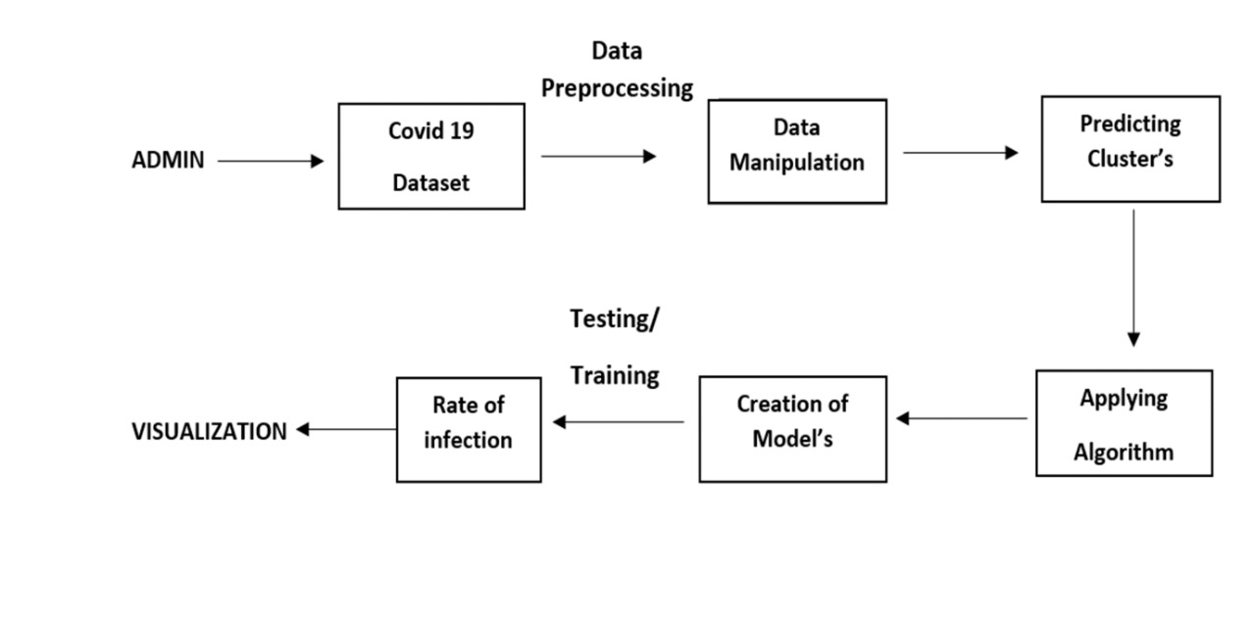

Go, change the world
RV College of
Engineering
Higher Level Design
Splitting the dataset
Data
User
Choosing Algorithm
Passing training data
Results
Tracking
Patients
TTRT
Fig 1.1. Block Diagram of the Proposed System

Slide 18
Model to Track Covid Patient
List of people who came in contact with patient and patient whereabouts
GPS Data
Medical Professional

Slide 19
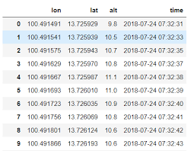

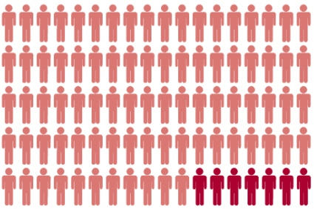
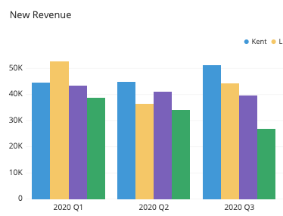
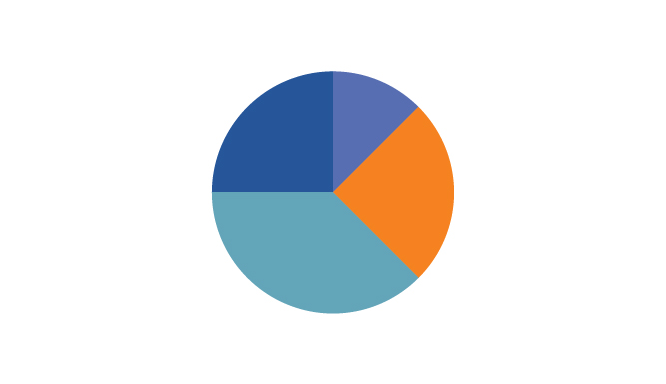
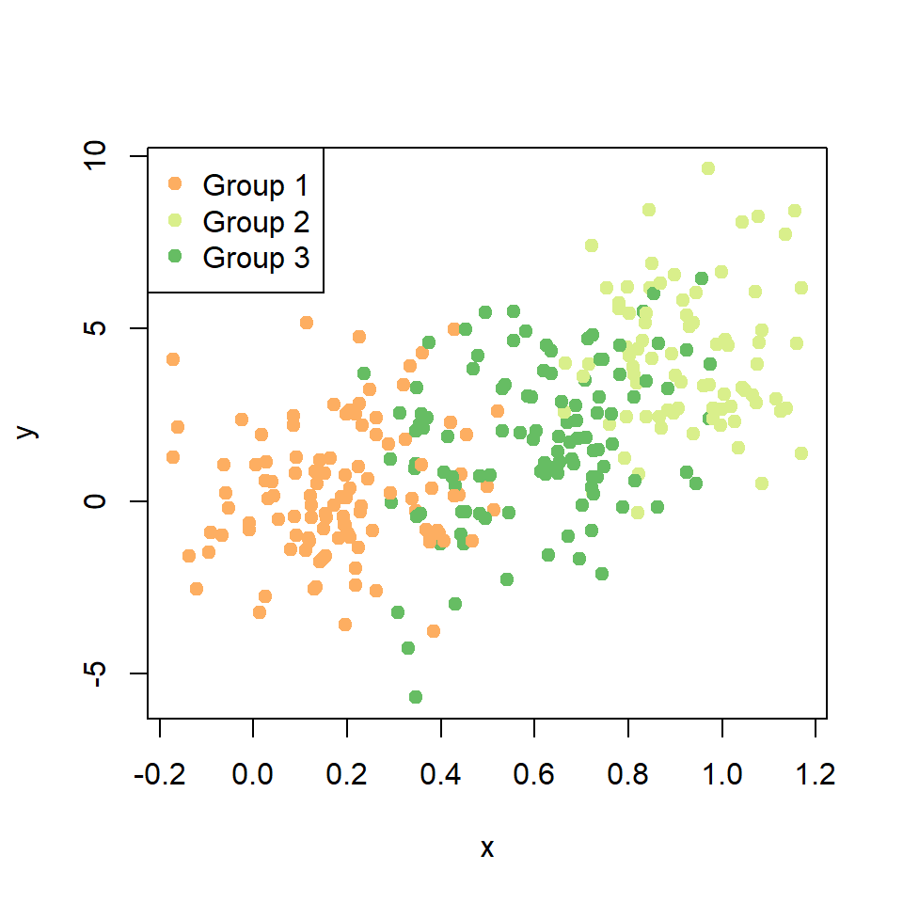
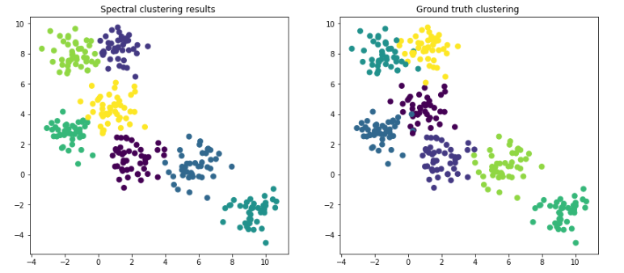
Go, change the world
RV College of
Engineering
Higher Level Design
Latitude & Longitude
ID,
Name
Dataset
Raw Data
Machine Learning
Data Processing
Infected/Non-Infected
City,
Area Code
Training Data
Testing Data
Training ML Model
Compare ML Model
Select ML Model
Deploy ML Model
Results
Prediction
Fig 1.2. Detailed Model of the Proposed System

Slide 20
Go, change the world
RV College of
Engineering
Higher Level Design
DFD – Level 0
0
Covid Patient Tracing and Diagnosis System
Medical Professional
GPS
data
Query Manipulation
List of probable infected patients

Slide 21
Go, change the world
RV College of
Engineering
Higher Level Design
DFD – Level 1
1
Patient Tracking
2
Infected Patient Diagnosis
3
Identification of probably infected patients
Latitude and Longitude
Medical
Professional
2 sets of latitude and longitude
Query Manipulation
List of infected and non-infected people
4
Probability of people being infected
Probability of the person being infected
Results

Slide 22
Go, change the world
RV College of
Engineering
Higher Level Design
DFD – Level 2 - Patient Tracking
1.1
Data
Processing
1.2
Map patient on graph
Medical
Professional
GPS
data
Latitude and Longitude
Visualize
Graphs
Fig 1.5. DFD – Level 2 - Patient Tracking

Slide 23
Go, change the world
RV College of
Engineering
Higher Level Design
DFD – Level 2 - Infected Patient Diagnosis
2.1
Predicting the Cluster
2.2
Analyse distance from patient to other individual
2 sets of latitude and longitude
Medical
Professional
Cluster
data
Results
List of People
Fig 1.6. DFD – Level 2 - Infected Patient Diagnosis

Slide 24
Go, change the world
RV College of
Engineering
Higher Level Design
Final DFD
1.1
Data
Processing
1.2
Map patient on graph
2.1
Predicting the Cluster
2.2
Analyse distance from patient to other individual
2 sets of latitude and longitude
Medical
Professional
GPS
data
Latitude and Longitude
Cluster
data
4.0
Probability of people being infected
3.0
Identification of probably infected patients
Probability of the person being infected
Results
List of infected and non-infected people
Query Manipulation
Fig 1.7. Final DFD

Slide 25
Go, change the world
Higher Level Design
Track
Patient
Data
Processing
Use Case Diagram
<<include>>
<<include>>
Map patient on graph
Infected Patient Diagnosis
<<include>>
Predicting the Cluster
<<include>>
Analyse distance from patient to other individual
Identification of probably infected patients
<<include>>
List of probable infected patients
Medical
Professional
Probability of people being infected
<<include>>
Probability value of the person being infected

Slide 26
Go, change the world
Higher Level Design
Medical
Professional
Load Data
Process data
Track Patient
Infected Patient Diagnosis
Identification of probably infected patients
[Infected]
List of infected people
[Not infected]
Probability value of the person being infected

Slide 27
Go, change the world
RV College of
Engineering
References
[1] Shen, Y., Guo, D., Long, F., Mateos, L. A., Ding, H., Xiu, Z., ... & Tan, H. (2020). Robots under COVID-19 pandemic: A comprehensive survey. Ieee Access, 9, pp. 1590-1615.
[2] Ahmed, N., Michelin, R. A., Xue, W., Ruj, S., Malaney, R., Kanhere, S. S., ... & Jha, S. K. (2020). A survey of COVID-19 contact tracing apps. IEEE access, 8, pp. 134577-134601.
[3] D’Angelo, Gianni, and Francesco Palmieri. "Enhancing COVID-19 tracking apps with human activity recognition using a deep convolutional neural network and HAR-images." Neural Computing and Applications (2021): pp. 1-17.
[4] Sharma, Tanusree, Tian Wang, and Masooda Bashir. "Advocating for users’ privacy protections: A case study of Covid-19 apps." 22nd International Conference on Human-Computer Interaction with Mobile Devices and Services. 2020. pp. 34-38
[5] Singh, Jaspreet, and Jagandeep Singh. "COVID-19 and its impact on society." Electronic Research Journal of Social Sciences and Humanities 2 (2020). pp. 134-149

Slide 28
Go, change the world
RV College of
Engineering
References
[6] Sujath, R., Chatterjee, J. M., & Hassanien, A. E. (2020). A machine learning forecasting model for COVID-19 pandemic in India. Stochastic Environmental Research and Risk Assessment, 34(7), pp. 959-972.
[7] Malki, Z., Atlam, E. S., Hassanien, A. E., Dagnew, G., Elhosseini, M. A., & Gad, I. (2020). Association between weather data and COVID-19 pandemic predicting mortality rate: Machine learning approaches. Chaos, Solitons & Fractals, 138 pp. 110137.
[8] Pinter, G., Felde, I., Mosavi, A., Ghamisi, P., & Gloaguen, R. (2020). COVID-19 pandemic prediction for Hungary; a hybrid machine learning approach. Mathematics, 8(6), pp. 890.
[9] Vaishya, R., Javaid, M., Khan, I. H., & Haleem, A. (2020). Artificial Intelligence (AI) applications for COVID-19 pandemic. Diabetes & Metabolic Syndrome: Clinical Research & Reviews, 14(4),pp. 337-339.

Slide 29
Go, change the world
RV College of
Engineering
References
[10] Jamshidi, M., Lalbakhsh, A., Talla, J., Peroutka, Z., Hadjilooei, F., Lalbakhsh, P., ... & Mohyuddin, W. (2020). Artificial intelligence and COVID-19: deep learning approaches for diagnosis and treatment. Ieee Access, 8, pp. 109581-109595.
[11] Osisanwo, F. Y., Akinsola, J. E. T., Awodele, O., Hinmikaiye, J. O., Olakanmi, O., & Akinjobi, J. (2017). Supervised machine learning algorithms: classification and comparison. International Journal of Computer Trends and Technology (IJCTT), 48(3), pp. 128-138.
[12] Amruthnath, N., & Gupta, T. (2018, April). A research study on unsupervised machine learning algorithms for early fault detection in predictive maintenance. In 2018 5th international conference on industrial engineering and applications (ICIEA) pp. 355-361.
[13] Ardabili, Sina F., Amir Mosavi, Pedram Ghamisi, Filip Ferdinand, Annamaria R. Varkonyi-Koczy, Uwe Reuter, Timon Rabczuk, and Peter M. Atkinson. "Covid-19 outbreak prediction with machine learning." Algorithms 13, no. 10 (2020): pp. 249.

Slide 30
User
Collection of data from Mockroo
Location of Infected covid patient
Tracking of high risk covid patient
Input the datatypes
Pass collected data through covid analysis model
Pass the Patient information to track other contacted people

Slide 31
0
Contact tracing using GPS data and ML
Pass Datatype requirement
User
Results
List of high-risk patients

Slide 32
1
Collection of data from Mockroo
2
Location of Infected covid patient
3
Tracking of high risk covid patient
User
Dataset Requirements
Data
Patient Details
Results
List of high-risk patients

